Slide 1
CUSTOMER RETENTION
Internship Presentation
SUBMITTED BY:
Amrutha Dhondale

Slide 2
CONTENTS
Introduction
Problem Framing
Data Pre-Processing
Conclusion

Slide 3
INTRODUCTION
Customer retention means the process of maintaining customers once you have acquired them. It is important to build a long-lasting relationship with the customers. He/she will buy more from you than a normal customer and also spread good words about your business which in turn increases your reputation and business. Customer retention is most important for every business, but it's especially significant for ecommerce organizations. Due to rapid growth of technology, business organizations have switched over from the traditional method of selling goods to modern method of selling goods. Business organizations uses e-commerce as a main communication to conduct commercial transactions.

Slide 4
There are few popular online shopping websites mentioned below:
Amazon
Flipkart
Myntra
Snapdeal
Pharmacy
Big Basket
These are some of the good facts for why people prefer online shopping instead of shopping from outdoor.
Saves time and efforts.
Convenience of Shopping at home.
Wide variety and range of products are available.
Good discounts and lower prices.
Get detailed information of the product.
We can compare various models and brands

Slide 5
PROBLEM FRAMING
I have to work on a project - Customer Retention. It’s all depending upon Online Shopping Websites which we are using all over the world. Now, I am going to analyze the detailed review of every online shopping websites which are used for shopping. I have given data in excel format.
I have some imported libraries like numpy imported for numerical computing, pandas imported for data manipulation and matplotlib and seaborn imported for visualizations and warning imported for to avoid the any warnings.
After imported the dataset, I found that there are 71 columns and 269 rows in the dataset. So, I have started working on the dataset.

Slide 6
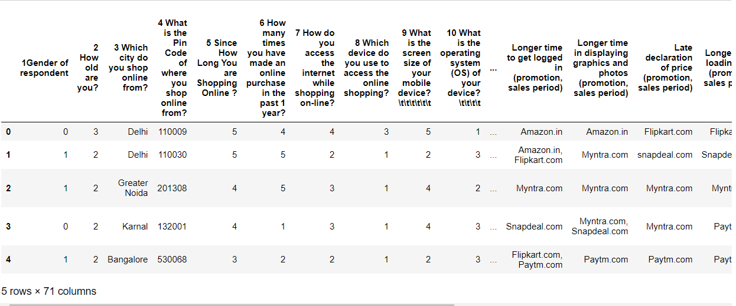
Data Pre-processing
Here we can find that columns are inappropriate way there is lots of punctuations present in the dataset

Slide 7
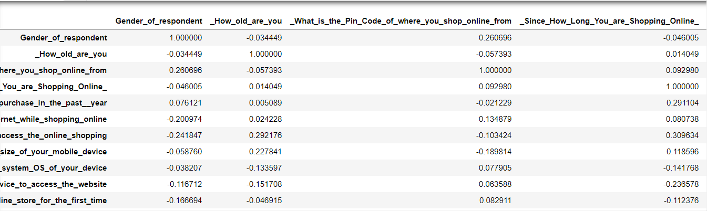
Checking correlation
Now here we have check the correlation and now we can identify the which all the columns are negatively correlated with each other and for better understanding we have plotted the graph as well.
Lets us plot the correlation

Slide 8


Slide 9
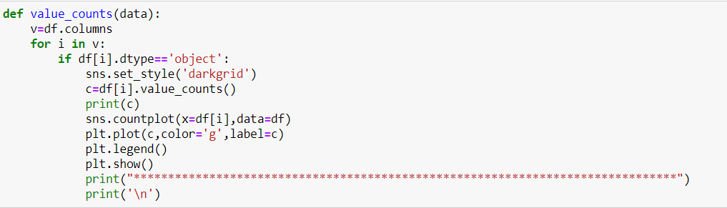
Univariate Analysis
In this data consists of only one variable. Here I have analyzed all the categorical and numerical dataset. In this one function to explore all columns
This is the functions which I have created to plot the categorical columns

Slide 10
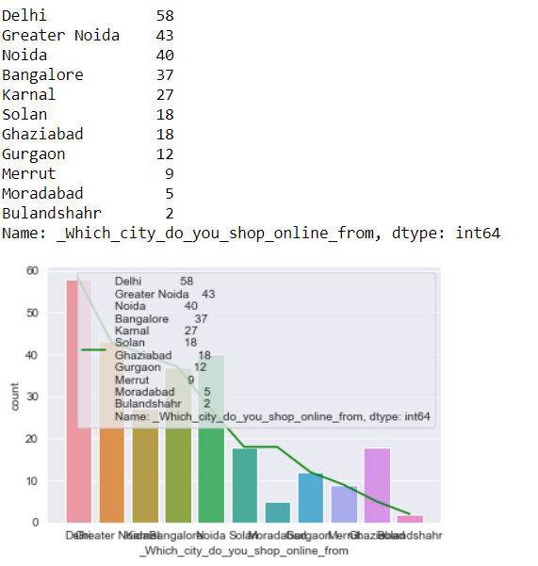
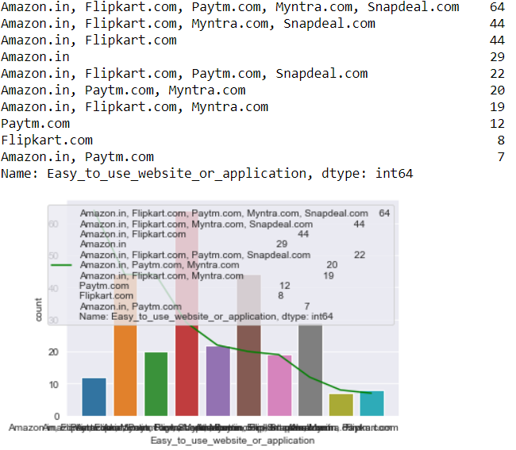

Slide 11
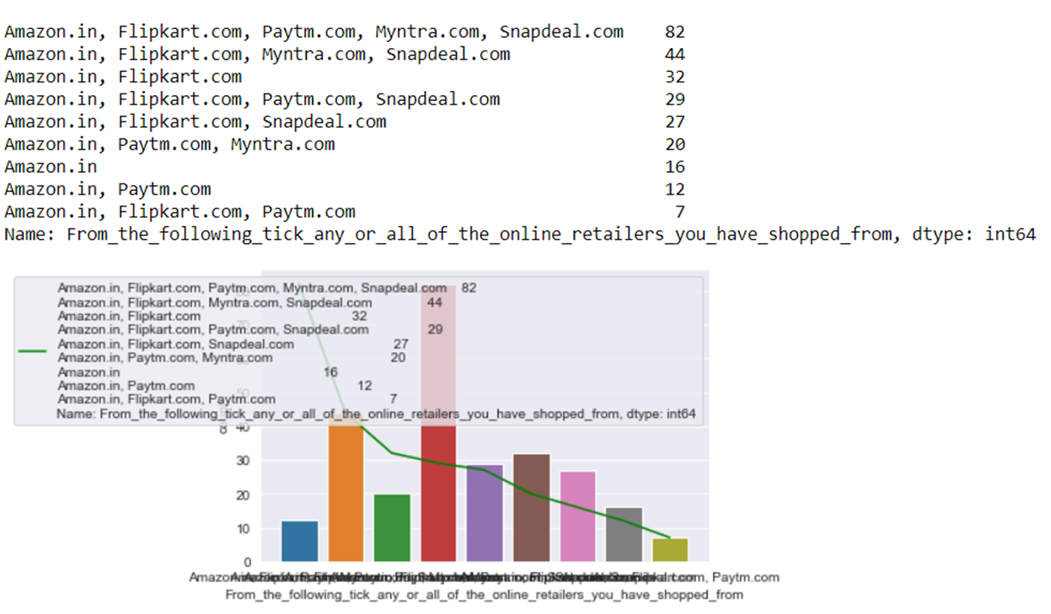

Slide 12
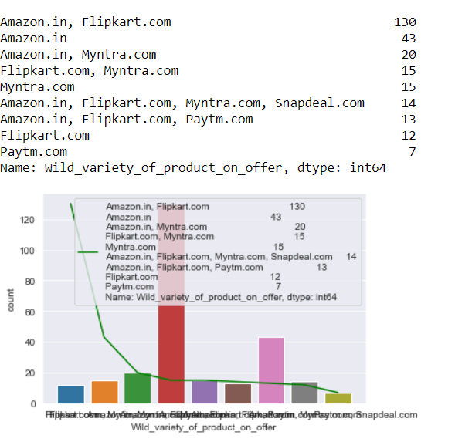
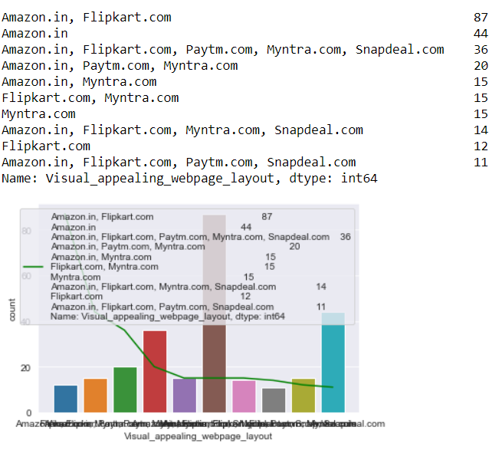

Slide 13
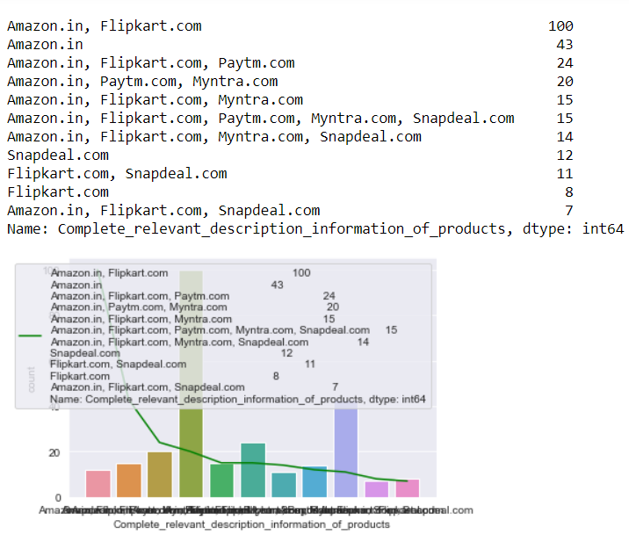

Slide 14
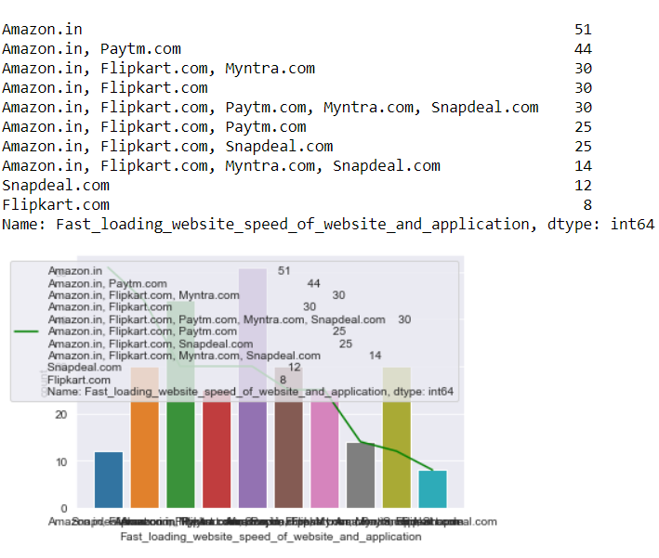
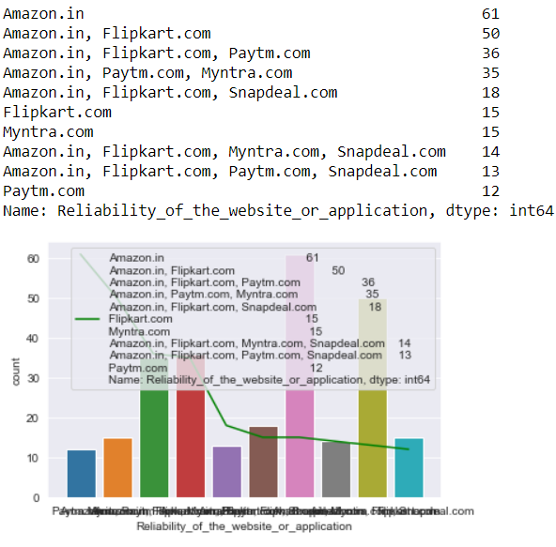

Slide 15
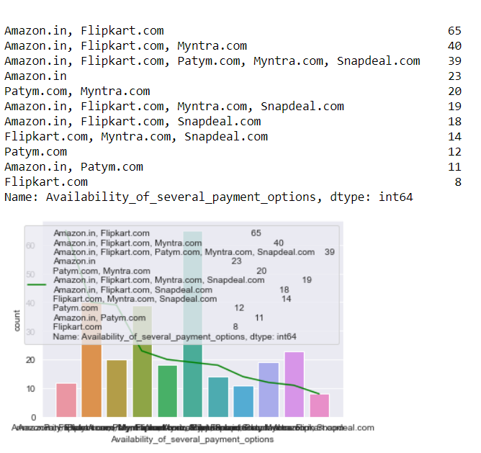
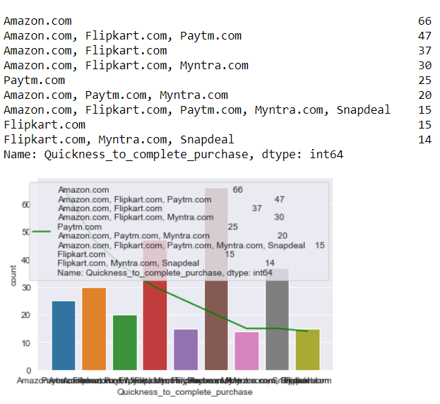

Slide 16
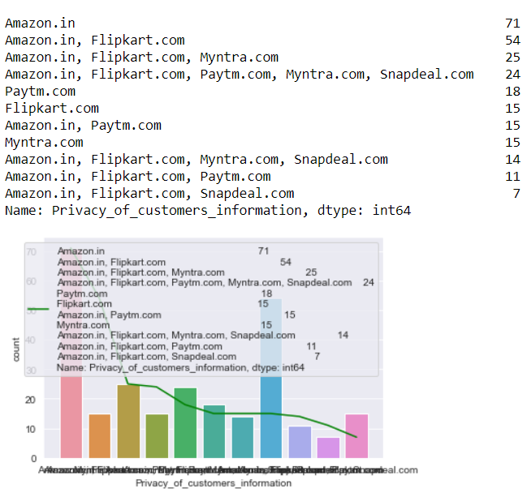
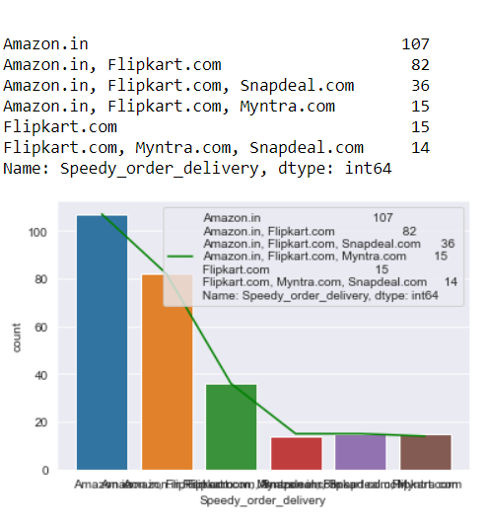

Slide 17
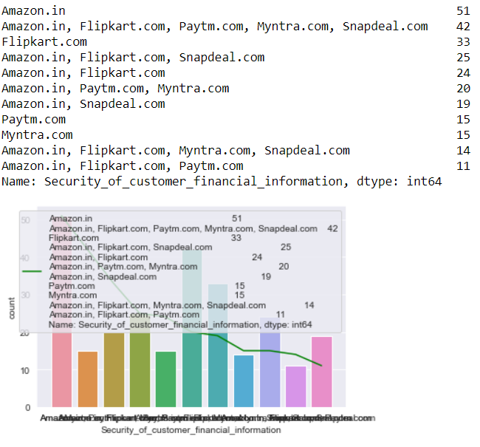
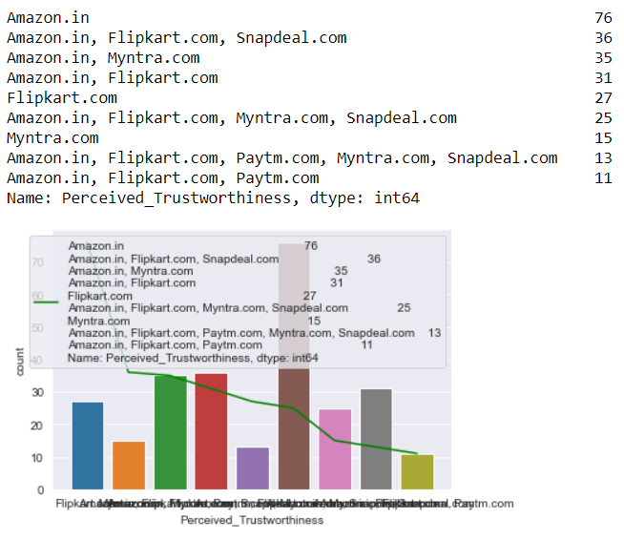

Slide 18
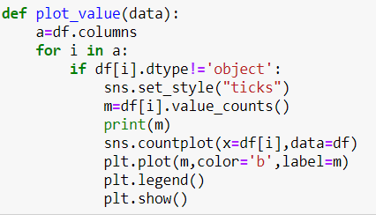
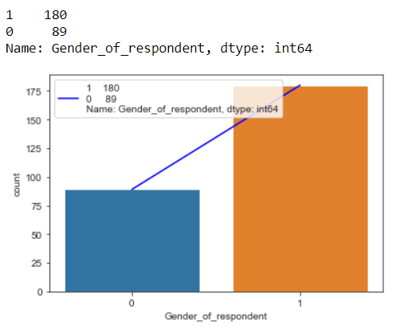
Now we will plot the numerical columns

Slide 19
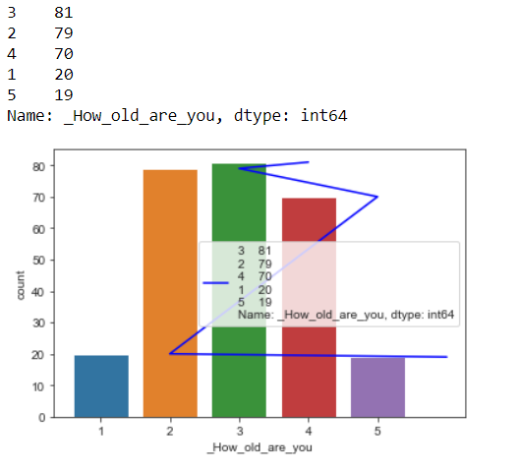
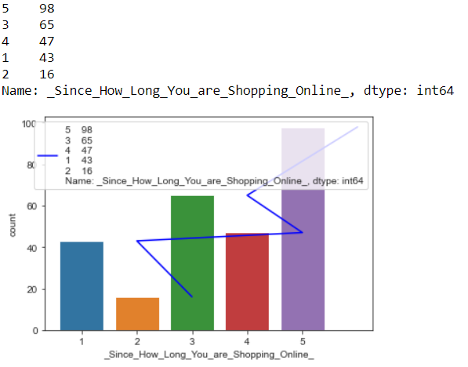

Slide 20
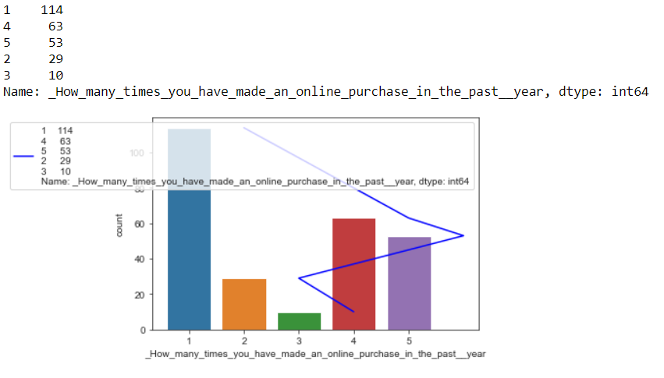

Slide 21
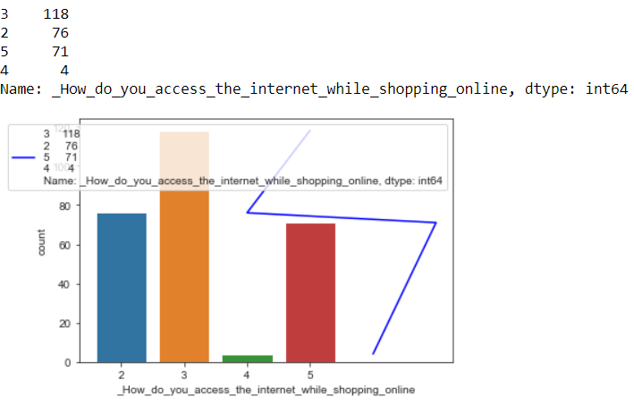
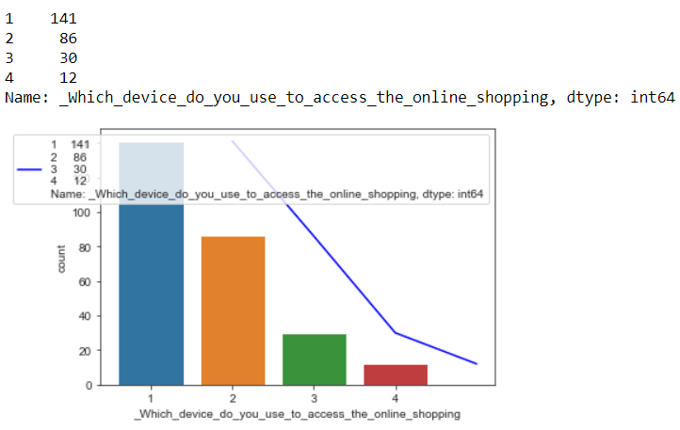

Slide 22
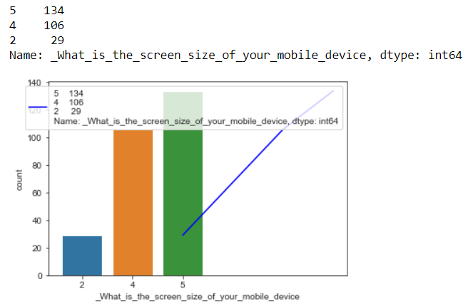
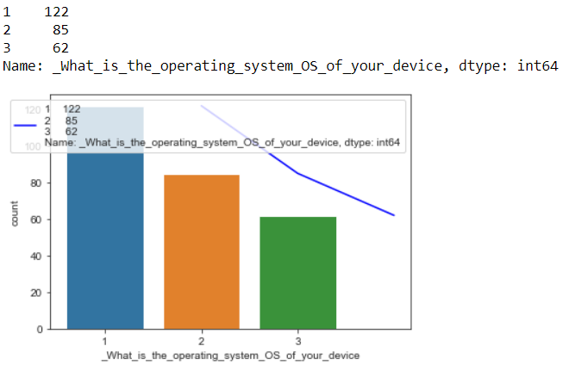

Slide 23
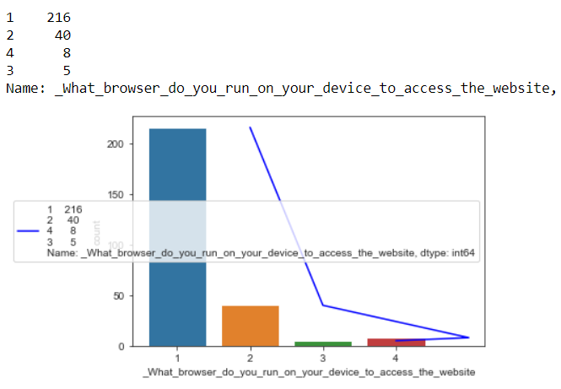
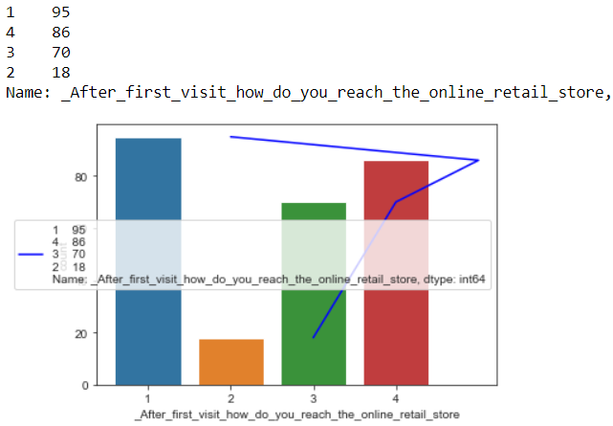

Slide 24
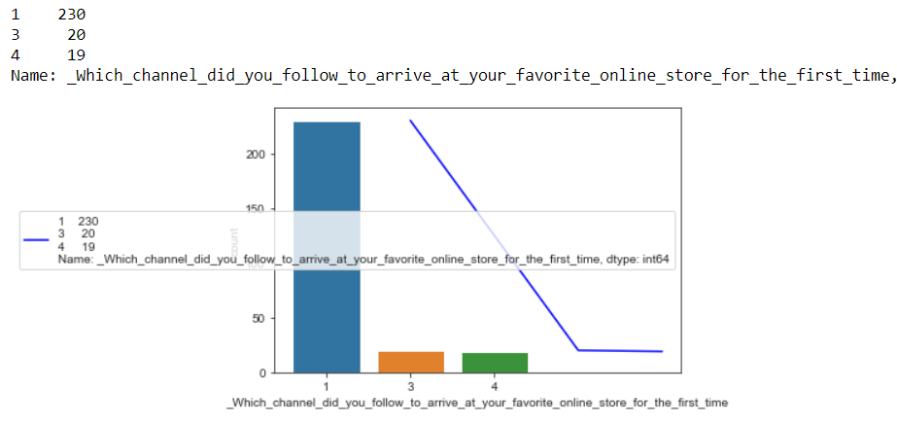

Slide 25
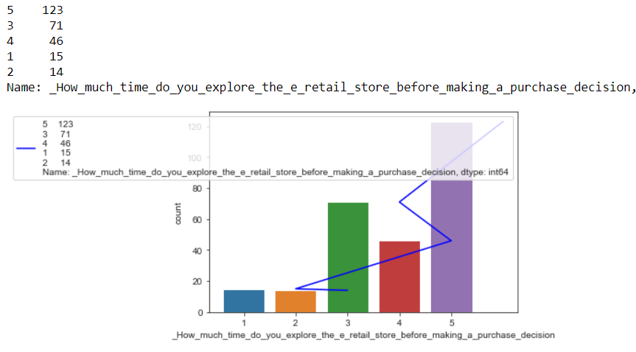

Slide 26
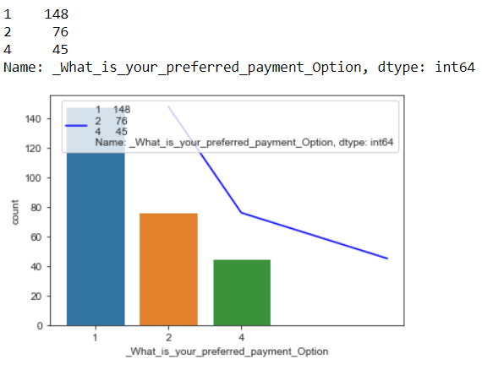
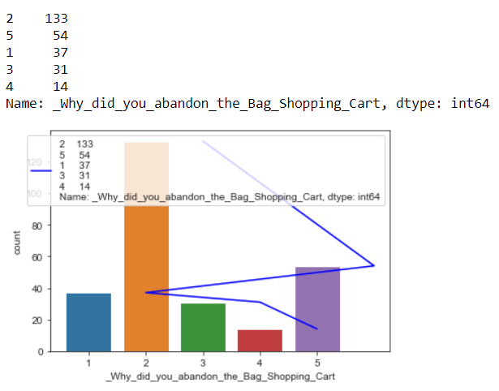

Slide 27
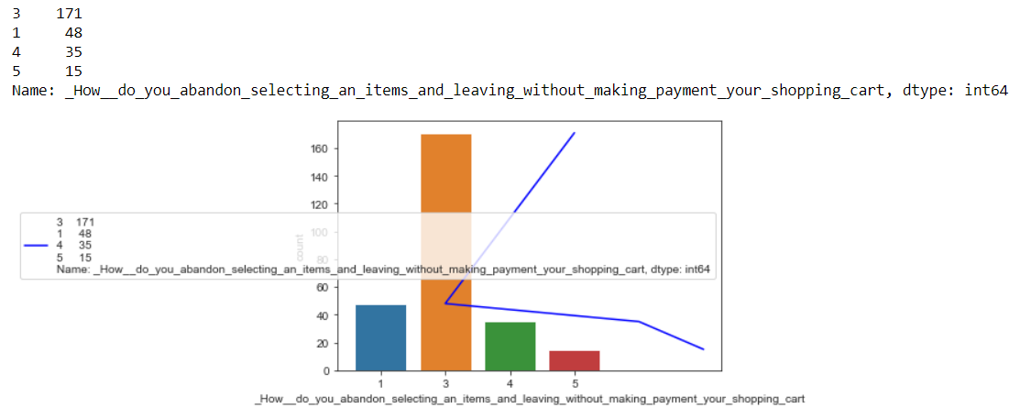

Slide 28
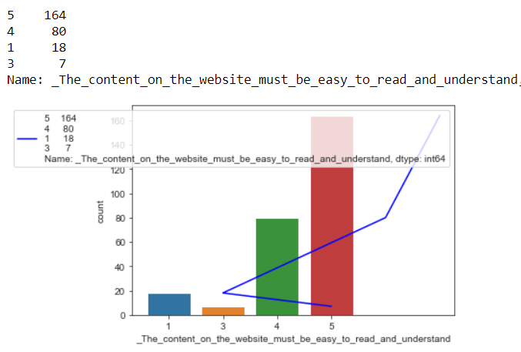
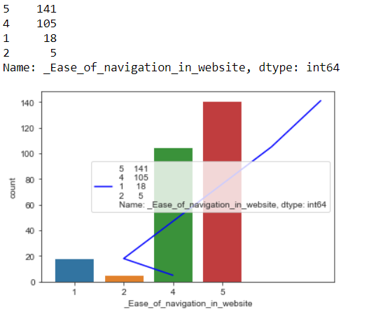

Slide 29
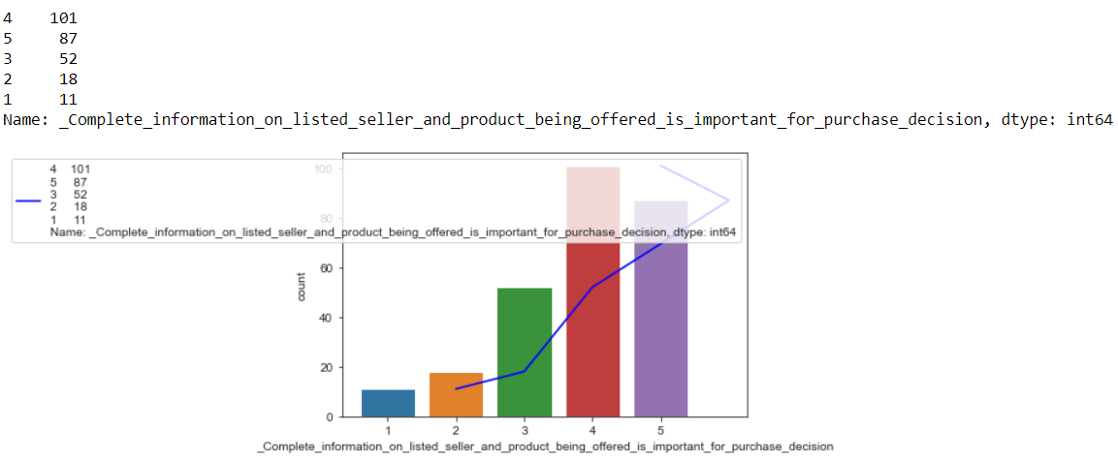

Slide 30
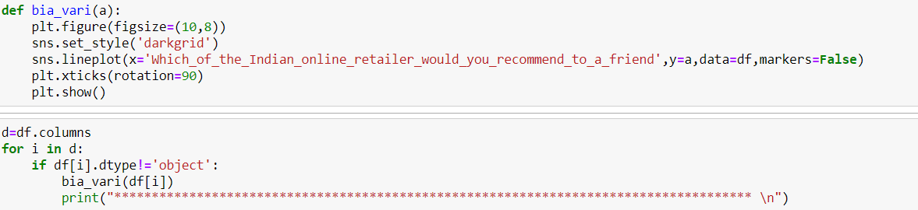
Bivariate Analysis

Slide 31
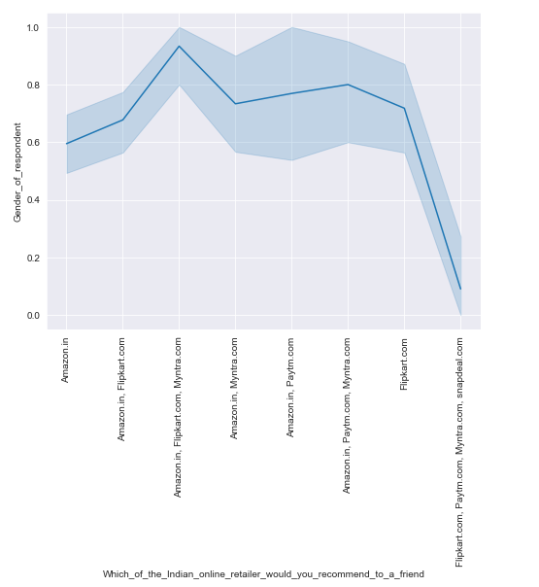
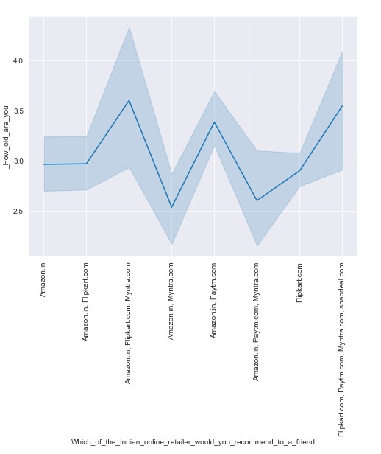

Slide 32
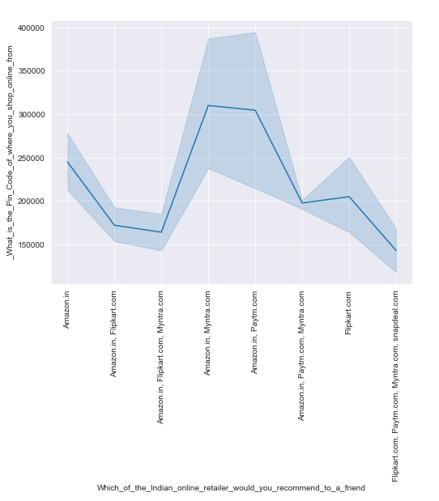
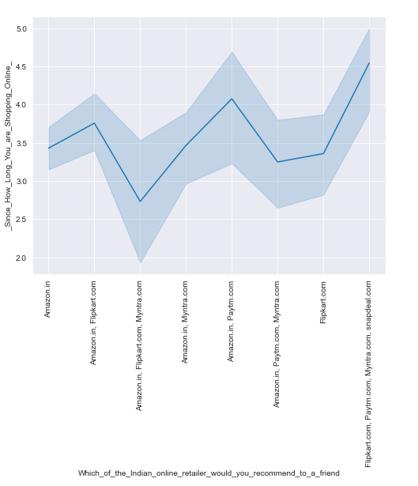

Slide 33
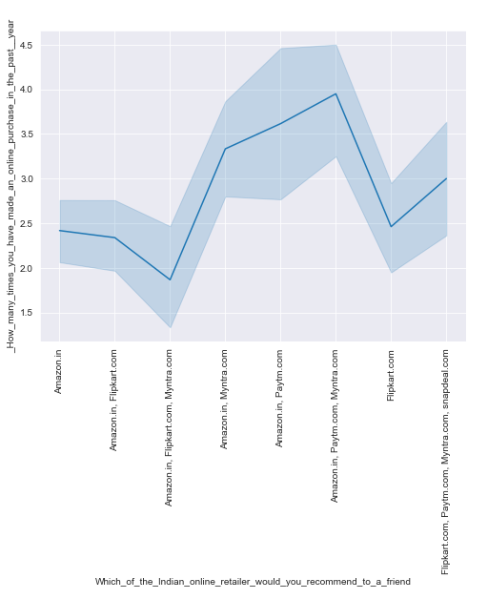
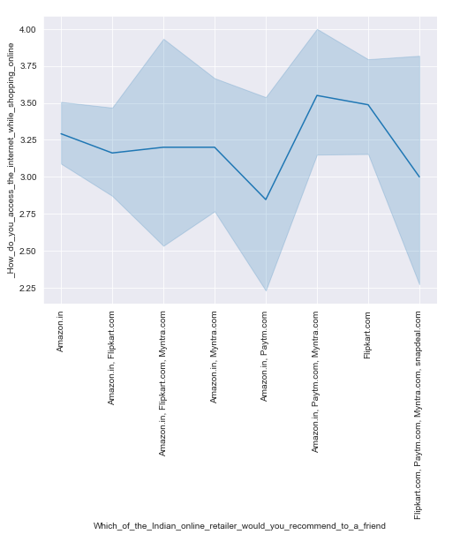

Slide 34
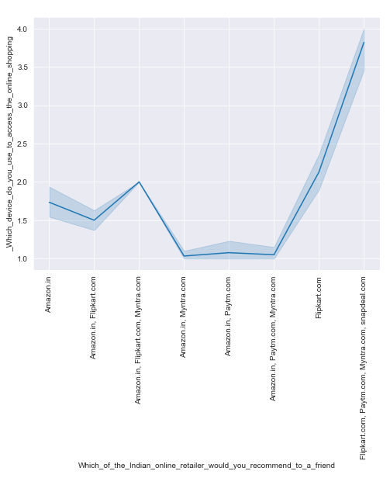
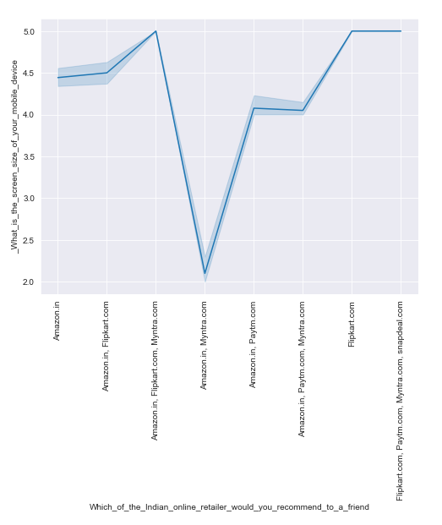

Slide 35
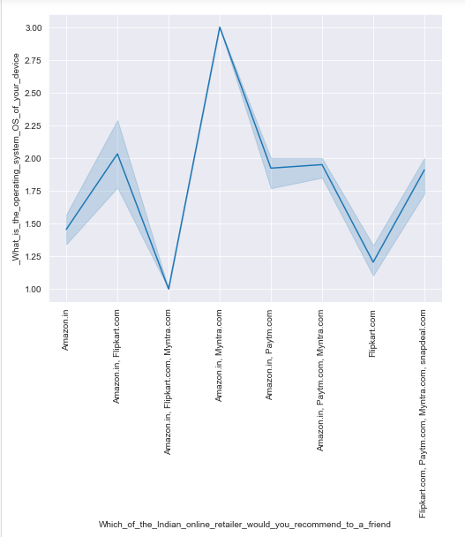
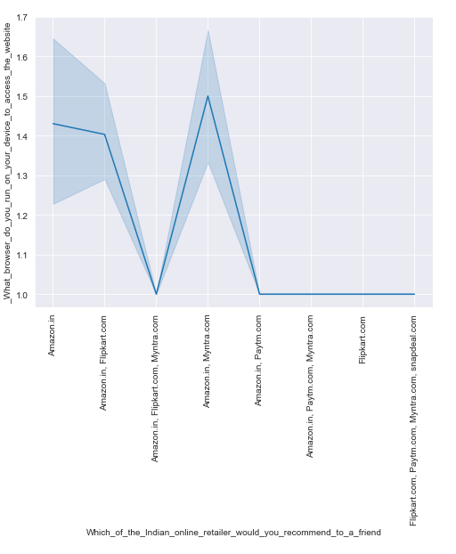

Slide 36
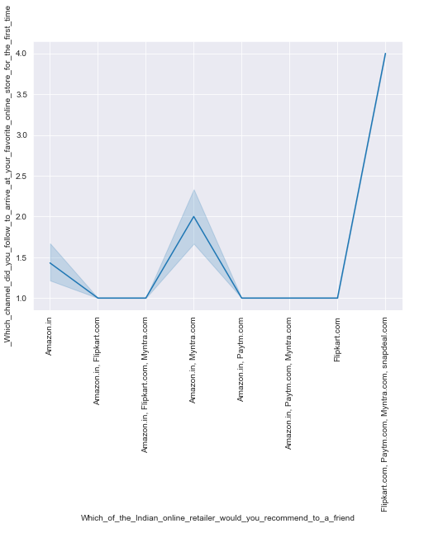
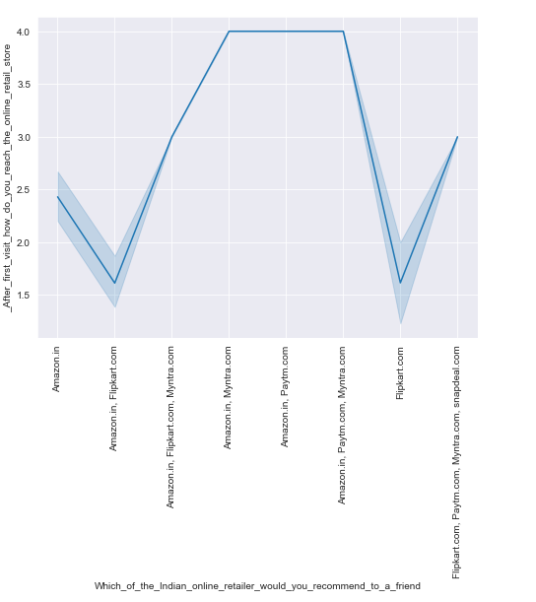

Slide 37
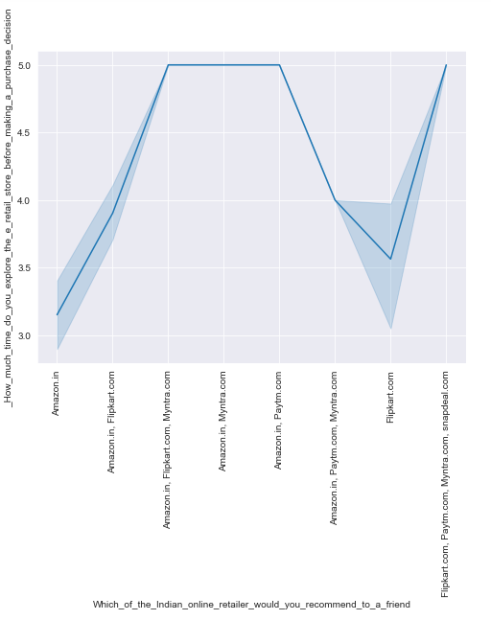


Slide 38



Slide 39



Slide 40



Slide 41



Slide 42



Slide 43



Slide 44



Slide 45

Categorical Columns

Slide 46


Slide 47


Slide 48


Slide 49


Slide 50


Slide 51

Multivariate Analysis

Slide 52


Slide 53



Checking Skewness

Slide 54




Slide 55




Slide 56




Slide 57




Slide 58
Thank you.
CONCLUSION
E-Commerce is not just about conducting business transactions via the Internet. This is because the revolution in information technology is happening simultaneously with other developments, especially the globalization of the business. The new age of global e-commerce is creating entirely new economy and that will tremendously change our lives, will reshape the competition in various industries, and alter the economy globally. As companies are gaining high profits, more and more other companies are developing their websites to increase their profits. Since more businesses are being held online resulting in high economy development and emergence of a more innovative and advanced technology.
In this project we have seen the which website is growing day by day.
.

